Slide 1


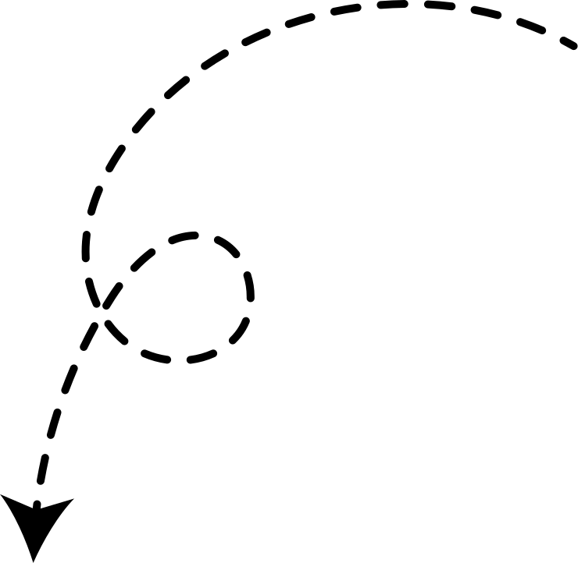

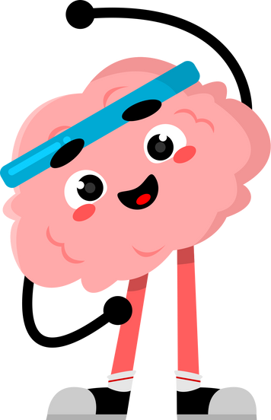


THE
CBT
Welcome!
We’re going to use this booklet to help us learn and explore new ideas together.
Your teacher will guide you, and you’ll have lots of chances to think, talk, and share your ideas.
Remember — there are no silly questions, and we’re all here to help and support each other.
Let’s get started!
COGNITIVE BEHAVIOURAL TRAINING
The more you put in, the more you get out!
WORKBOOK
FOR CHILDREN

Slide 2

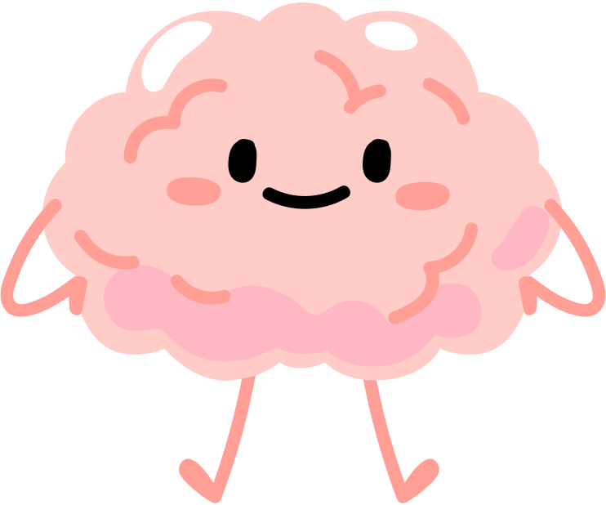
INTRODUCING CBT
What is CBT?
CBT stands for Cognitive Behavioral Training - but don’t worry, that’s just a fancy way of saying "how our thoughts, feelings, and actions work together!"
Have you ever felt really nervous before a test? Or upset because of a problem with a friend? CBT helps you notice tricky thoughts and turn them into more helpful ones so you can feel better and stay in control.
So, why should you learn about it?
Because it’s like a superpower for your brain! It gives you tools to handle big feelings, solve problems, and feel happier.
With CBT, you can face challenges with a clear mind and a brave heart!
1

Slide 3


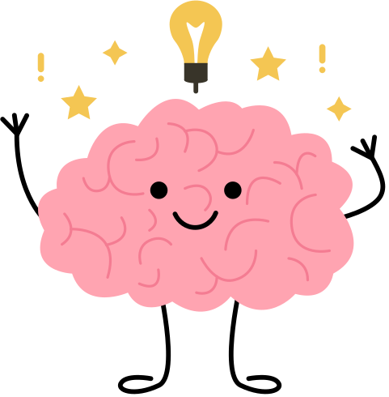


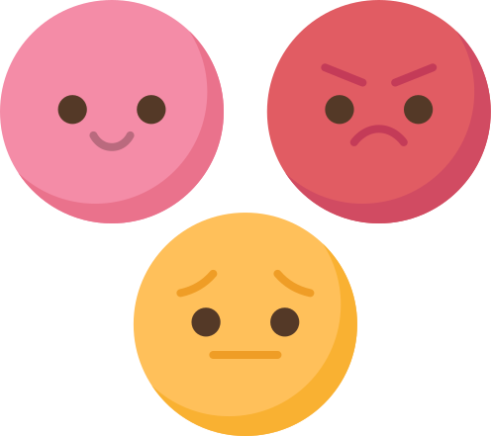
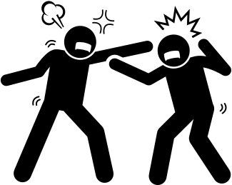

THE
CBT TRIANGLE
The CBT Triangle: How Thoughts, Feelings, and Actions Are Connected!
Thoughts
The Three Points of the CBT Triangle are:
  Thoughts: What we say to ourselves in our head (like, “I can’t do this!” or “I’ll try my best!”)
  Feelings: How those thoughts make us feel (like happy, nervous, or upset)
  Actions: What we do because of those feelings (like avoiding something, lashing out, or making a good choice).
All three are connected - like a team that works together! When we work on one point of the triangle, it can change the others too!
Next, we’ll learn how to boss our thoughts by asking:
  “Is this thought true?”
  “Is it helpful?”
When we change unhelpful thoughts, we can feel better and make better choices!
Actions
Feelings
A Football Example!
Imagine a football player thinking, "I’m going to mess up!"
  This thought makes them feel nervous.
  Because they feel nervous, they hesitate when the ball comes their way.
  Then, they miss the ball and think, "See? I knew I’d mess up!"
  This makes them feel even more nervous next time, and the cycle keeps going!
But here’s the good news… we can break the cycle! If the player changes their thought to "I’ll try my best!", they’ll feel more confident, act braver, and play better!
2
3

Slide 4

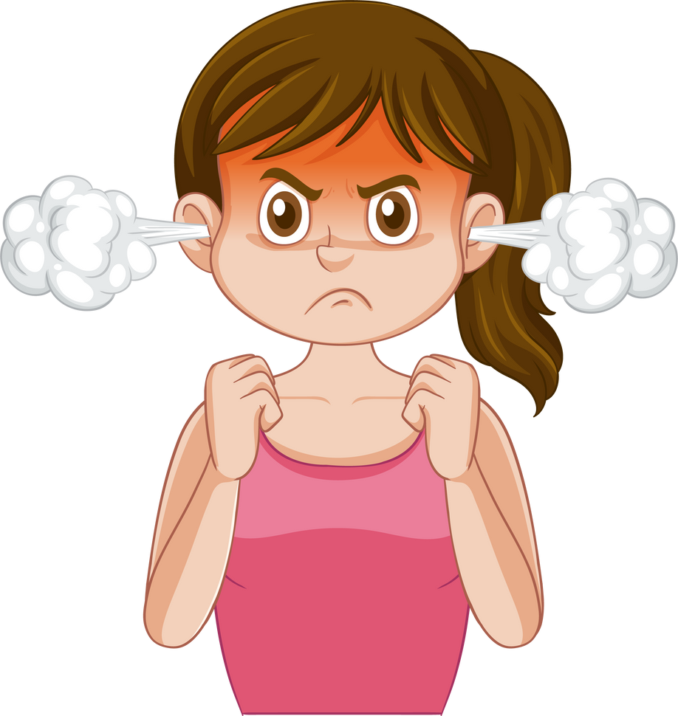

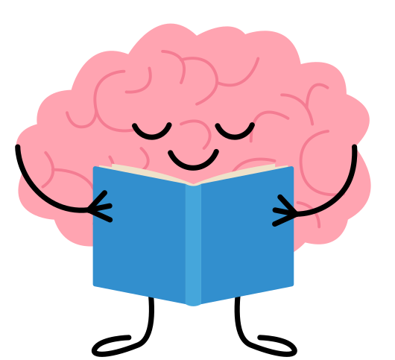





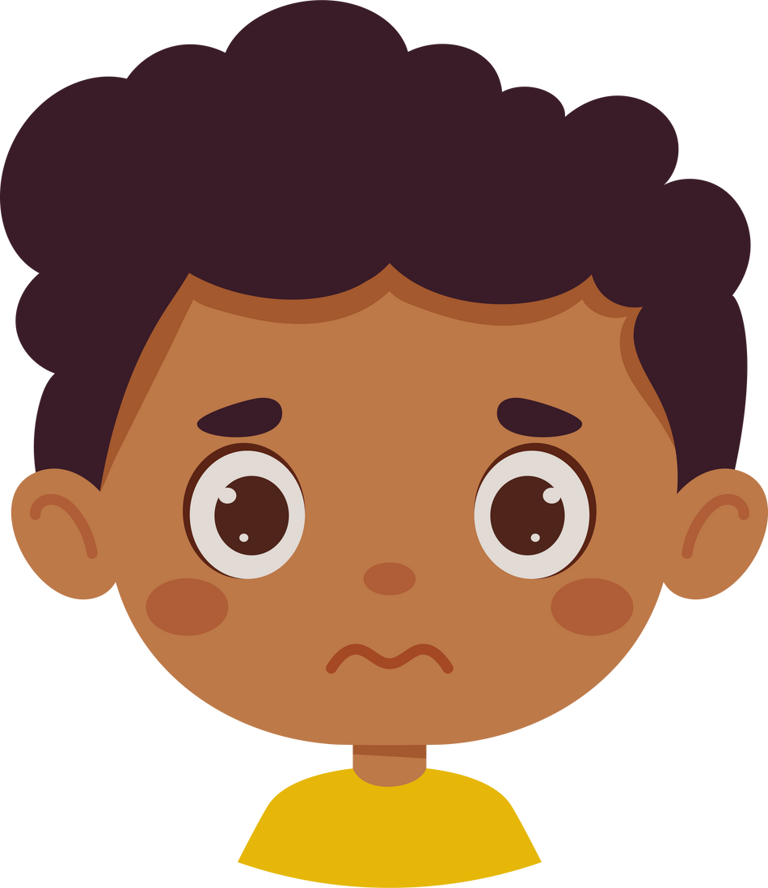

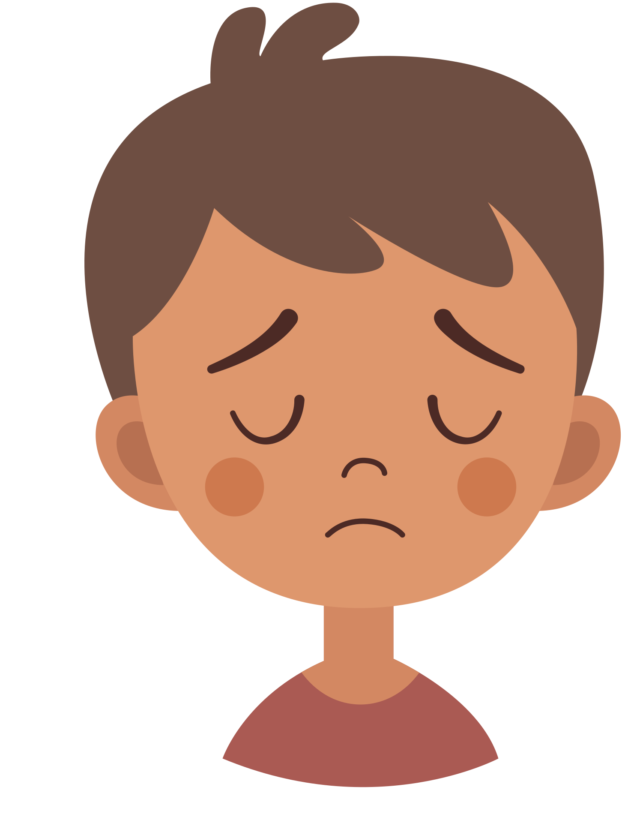
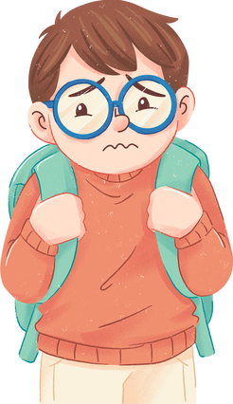

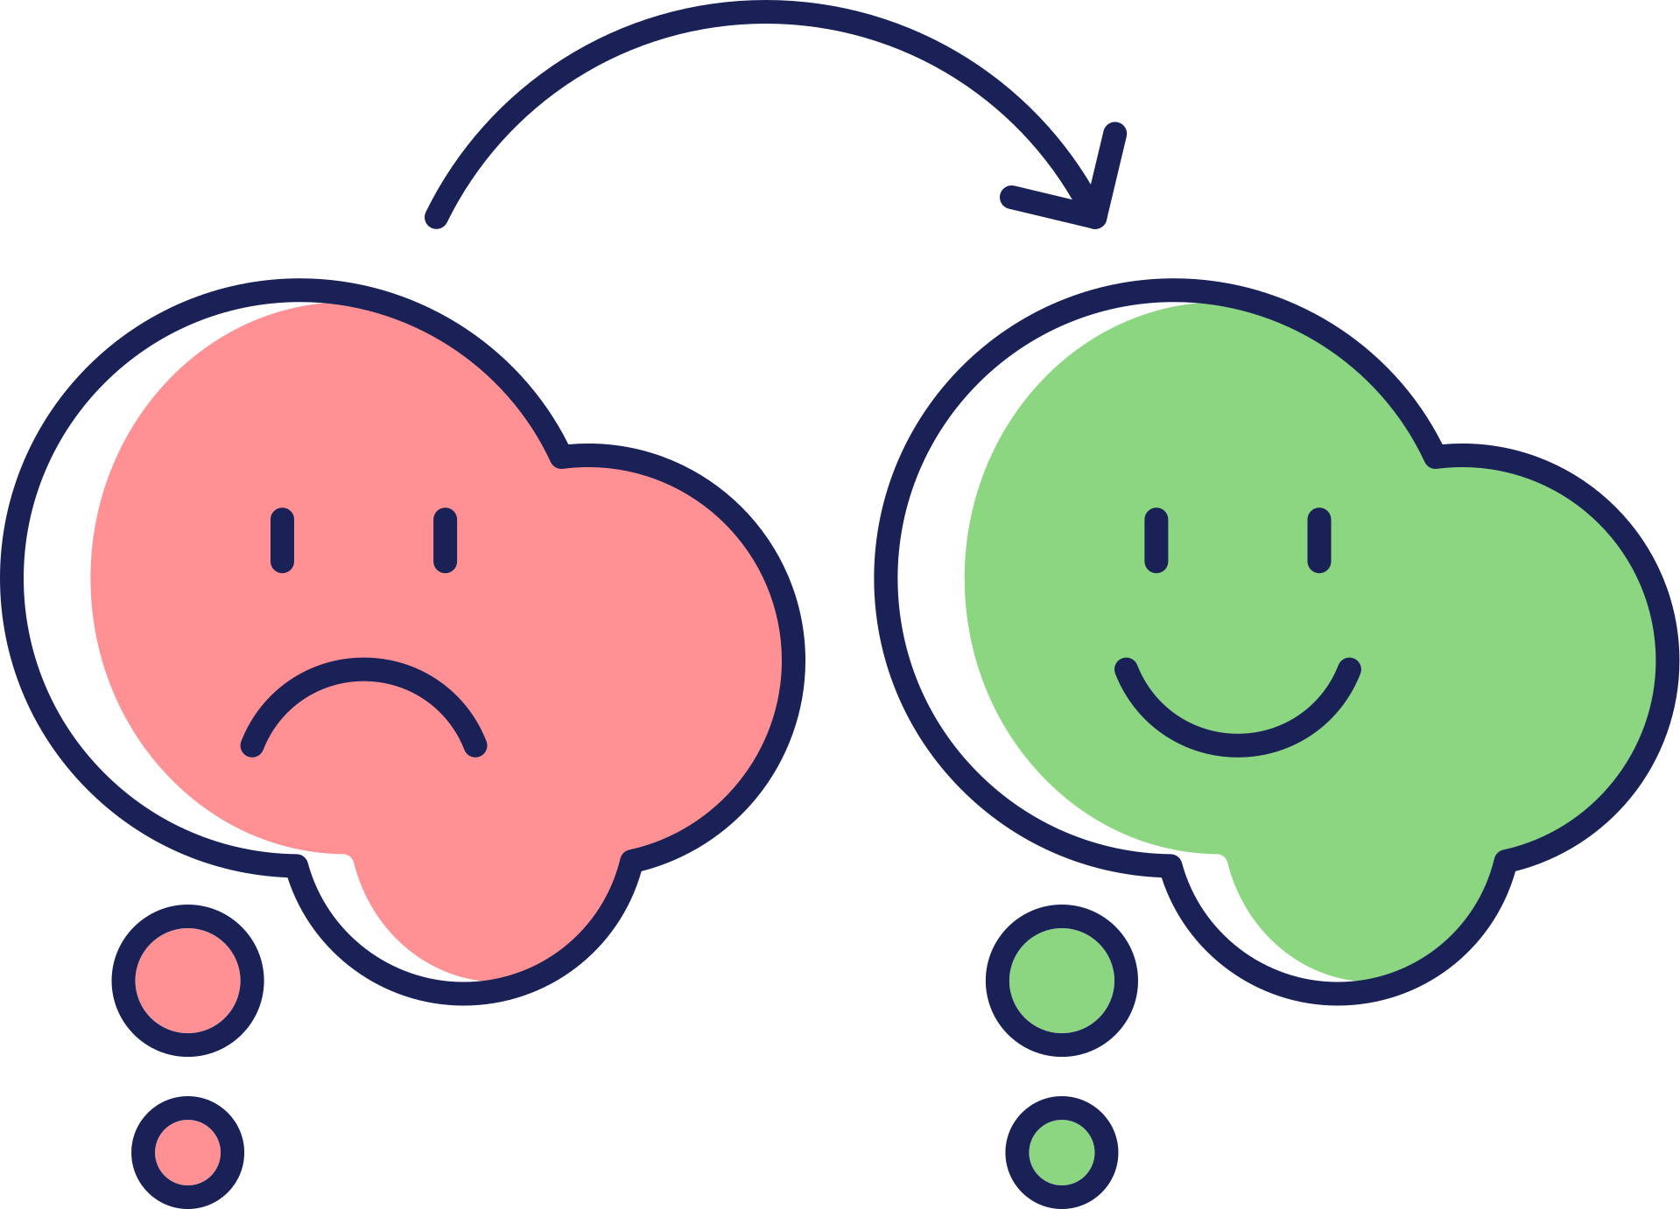
CAN YOU SPOT THE MIND TRAPS
IN THESE THOUGHTS?
MIND
TRAPS
Circle the mind traps in the thoughts and label them
Did you know our brains don’t always tell us the truth?
Sometimes our brains like to trick us!
Look out for these mind traps!
Mum always tells me off for not tidying my room!! She thinks I’m lazy and I’m not!!
fortune
telling
mind
reading
should
statements
blame
Thinking you can see into the future
“I’m going to
do so badly!”
Assuming you know what others are thinking.
Shoulda, woulda, coulda!
Stop ‘should’
statements.
Blaming others
or yourself when that’s not fair.
I’m going to do so badly in the school play! Everyone’s going to laugh at me! I’m an idiot!
magnification
black & white
thinking
Catastrophising
mental
filter
Turning small things into a BIG deal.
Most things aren’t black or white:
“I didn’t get top marks so I FAILED.”
Imagining the
worst possible thing to happen.
Dwelling on the
bad stuff and not counting the
good stuff.
My friend didn’t
sit next to me on the bus.
I must have done something wrong.
Why doesn’t he like me any more?
over -generalisation
personalisation
feelings
as facts
labelling
Seeing one bad thing as a pattern: "This always happens to me!"
You take things personally when it wasn’t meant that way.
"I feel stupid,
so that means
I must be stupid."
Instead of saying:
‘I made a mistake’ you say:
‘I’m a loser.’
always ask yourself two questions:
Is my thought true?
Is my thought helpful?
Remember! You can change the way you feel
by changing your thoughts
are these thoughts helpful? Are they true?
can you think of other thoughts
which are more helpful and realistic?
4
5

Slide 5




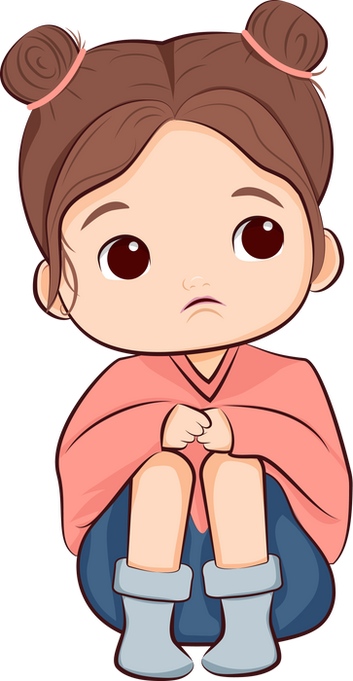

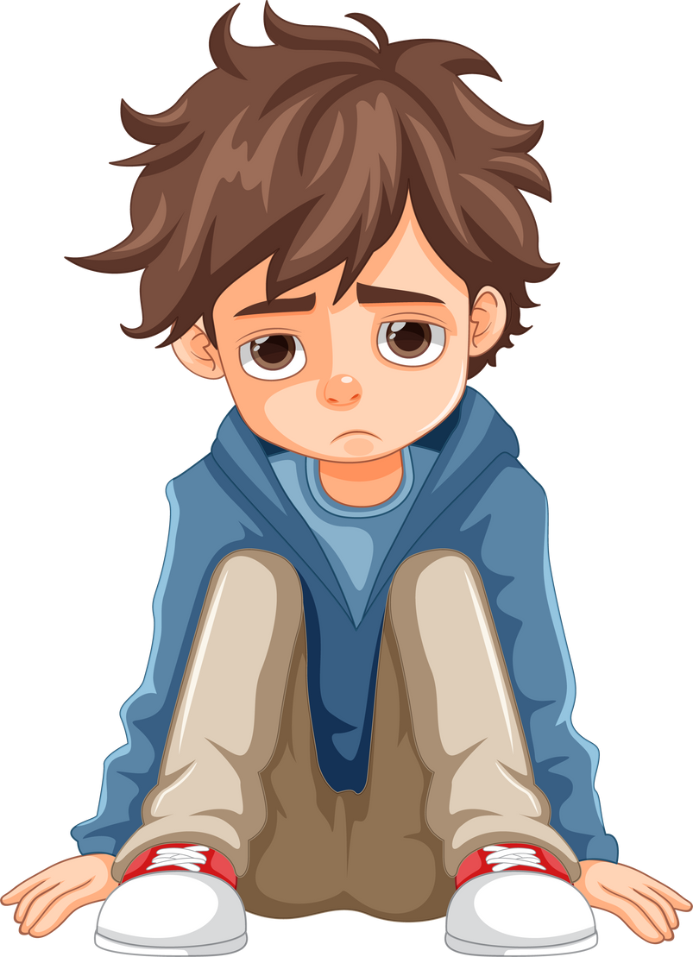


FLIPPING TRICKY THOUGHTS
example of mind traps
Once we spot a tricky thought, we can flip it into a more helpful one - just like flipping a pancake! But remember, the key is to keep it realistic and positive.
Now, take a minute to look at the example on the opposite page. The girl has noticed some mind traps in her thinking - but what could her new thought be?
She might think, "I’m so popular! Everybody likes me!" But wait - is it really possible for everyone to like us all the time? Here’s a better flipped thought:
Mind Reading
over-generalisation
You don’t know what other people are thinking
"No one ever wants to play with me. They think I’m boring. I’m a loser."
No one? Ever?
Is that true?
labelling
self-blame
Words like ‘loser’ draw on ‘black & white thinking’ and never tell the full story. Would you use this term to describe someone else?
“Just because I haven't been asked to hang out lately doesn't mean people don't like me. Everyone is busy with their own stuff. I can always reach out and make plans!”
Don’t blame yourself
for other people’s actions
Look at the thoughts below. Spot the ‘mind traps’ then have a go at creating a more helpful ‘flipped’ thought.
I failed my spelling test. I’m so stupid. The work at secondary is going to be too hard for me.
mind traps
Flipped thought
I’m going to get lost at big school. I’m never going to find my way around."
6
7

Slide 6
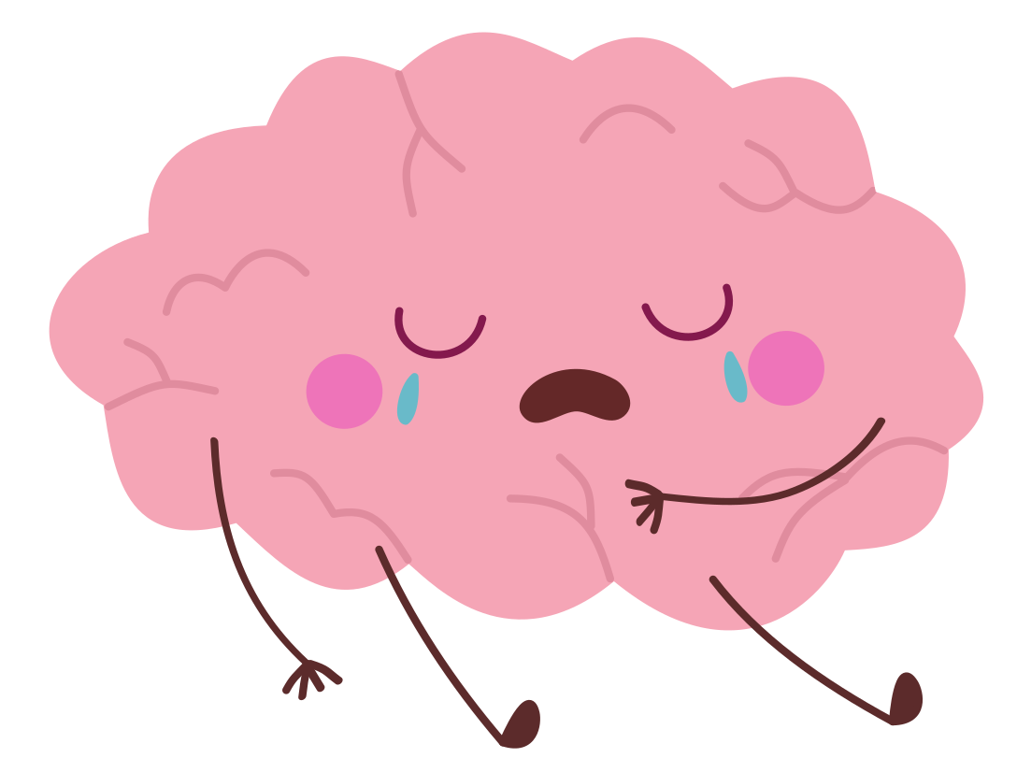



MIND TRAPS
WORKSHEET
NOT FEELING GREAT?
FILL OUT THIS WORKSHEET TO REBOOT YOUR THOUGHTS AND FEELINGS!
Before you start, how do you feel? Rate your emotions out of 10.
I am feeling
SAD:
ANGRY:
WORRIED:
EMBARRASSED:
FRUSTRATED:
GUILTY:
NERVOUS:
WHAT’S YOUR THOUGHT?
MIND
TRAPS?
WHAT’S YOUR
MORE HELPFUL THOUGHT?
Thought 1
Thought 2
Thought 3
Finished? Do you feel a little better? Rate your emotions out of 10 again.
I am feeling
SAD:
ANGRY:
WORRIED:
EMBARRASSED:
FRUSTRATED:
GUILTY:
NERVOUS:
over -generalisation
personalisation
feelings
as facts
labelling
magnification
black & white
thinking
Catastrophising
mental
filter
fortune
telling
mind
reading
should
statements
blame
Turning a negative event into a pattern: “This always happens!”
You take things personally when
it wasn’t meant
that way.
“I feel like an
idiot so I must
be one.”
Instead of saying:
‘I made a mistake’ you say:
‘I’m a loser.’
Turning small things into a big deal.
Most things aren’t black or white - they’re on the greyscale.
Imagining the
worst possible thing to happen.
Dwelling on the negatives and not counting the positives.
Thinking you can predict the future.
Assuming you know what others are thinking.
Shoulda, woulda, coulda!
Stop ‘should’
statements.
Blaming others
or yourself when that’s not fair.

Slide 7


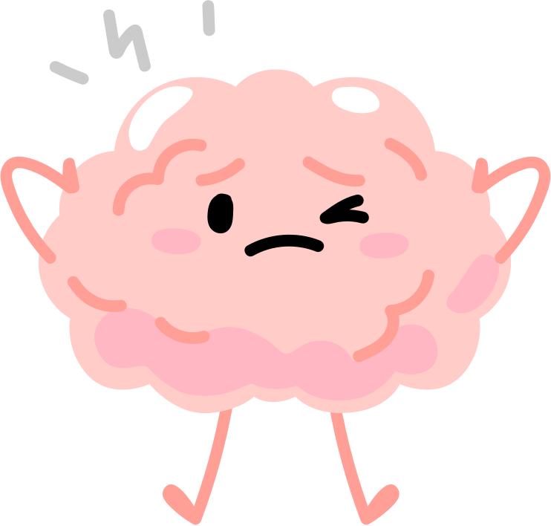

WHEN FEELINGS ARE TOO BIG
Help! My feelings are too BIG to do a worksheet!
Sometimes, feelings can get really big, like when you're super angry or scared, and it can make it hard to focus on things like a worksheet. But remember - big feelings don’t last forever!
Here are some quick ways to help you feel calm again. (And when you’re ready, you can try the worksheet!)
box breathing
grounding
distraction
Muscle Relaxation
When you feel really angry or worried, it can help to distract your mind for a bit.
You can try things like:
  Listening to music
  Playing with friends
  Going for a walk
  Counting to ten
  Drawing
These activities help you take a break from big feelings.
Even better, moving your body, like running or jumping, can help you feel better and clear your mind.
By doing something else, you can feel calmer and see things more clearly.
  Breathe in through your nose for 4 seconds.
  Hold your breath for 4 seconds.
  Breathe out slowly through your mouth for 4 seconds.
  Hold again for 4 seconds.
Do this 3 to 5 times. It helps you feel calm and less panicky.
The 5-4-3-2-1 grounding exercise:
  5 things you can see – Look around and name five things you can see.
  4 things you can touch – Feel four different things around you.
  3 things you can hear – Listen for three sounds.
  2 things you can smell – Focus on two smells (if you can).
  1 thing you can taste – Notice any taste in your mouth.
This helps you feel more in the moment and calm again.
  Sit or lie down comfortably
  Make tight fists with your hands. Hold for a few seconds, then let them go and relax.
  Make your arms stiff. Hold for a few seconds, then let them relax.
  Shrug your shoulders up to your ears. Hold, then let them drop and relax.
  Scrunch up your face. Hold, then let it go soft.
  Stretch your legs out. Hold, then let them relax.
Take a big breath and feel your body calm down!
In
Hold
Hold
Out
10
11

Slide 8


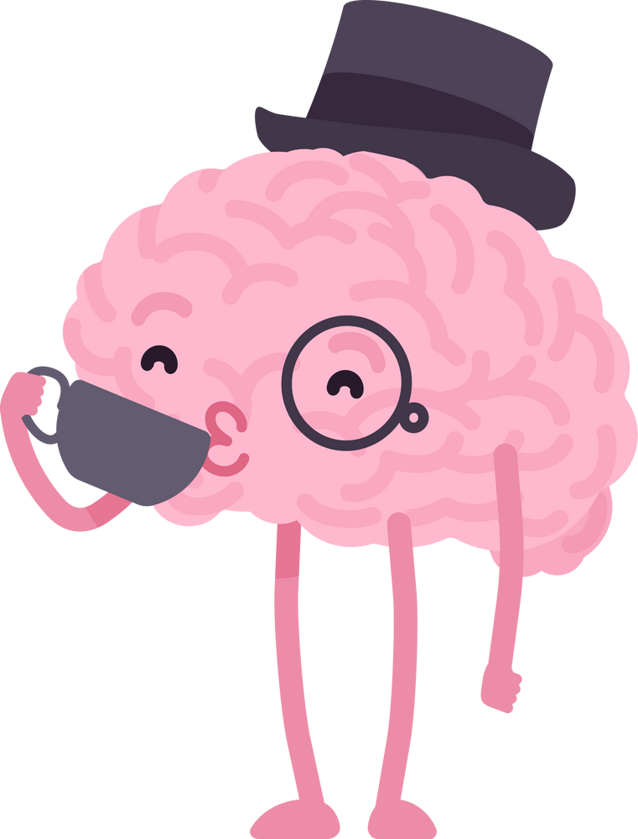
KNOW YOURSELF
FINAL NOTE
Knowing yourself
is one of the most important things you can do.
It’s about knowing what makes you feel happy, calm, or upset.
Does playing sports help you feel happy? Does spending too much time on your tablet make you feel drained? The more you know what helps or hurts how you feel, the better you can take care of yourself.
Think about things you do that make you feel good or bad. For example, staying up late might feel fun, but how do you feel the next day? Eating junk food is a treat, but does too much make you feel tired? Pay attention to how what you do affects how you feel.
Put a tick next to things that make you feel good, and a cross next to things that don’t.
Well done for finishing this workbook!
Remember, feelings aren’t good or bad - they’re just helpful or unhelpful. It’s okay to feel angry, sad, or worried, but if those feelings make things harder, that’s when you can change them.
As you keep going, ask yourself if your thoughts are really true. Always be on the look-out for mind traps! Be kind to yourself, just like you would be to a friend.
Negative thoughts can come back - but that doesn’t mean CBT isn’t working! It just means it’s time to try a worksheet again.The more you practice, the easier it gets! You don’t need this workbook every time - just a pen and paper to keep practicing.
And remember - if you ever feel really sad, angry, or worried, it’s really important to talk to a trusted adult. You are never alone - there are always people who care about you and want to help.
You’ve got this!
Watching TV
Reading a book
Going to bed late
Playing with friends
Listening to music
Playing a sport
Helping someone else
Writing a journal
Homework
Dancing and singing
Watching online videos
Eating junk food
Going for a walk
Being by myself
Taking a bath / shower
Having a tidy bedroom
Getting up early
Gaming
Playing an instrument
Sleeping
ME
12
13

Slide 9

YOU GOT
THIS!
this workbook is based on the work of
Dr aaron t. beck, father of cbt, and Dr David Burns, author of ‘the feeling good handbook’
To print worksheets and
download resources visit:
www.cbt-workbook.org

